Slide 1

Mastering Voice UX
FEATURING AMAZON'S ECHO (AKA ALEXA)
Notes:
Thank you for coming to this talk at the end of Day 1. Everyone’s brain is probably full of new knowledge.
This topic is something that became extremely interesting to me in the last year.

Slide 2


Slide 3


Slide 4
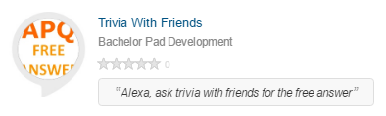

About Me
Chris Pauly
.NET developer since 2004
Alexa owner since Jan. 2015
Published skills
Notes:
Thick client and server applications
Recently dealing with web applications using ASP.NET webforms MVC
The Alexa development platform is what got me interested in this topic that I’m here to talk about today.

Slide 5
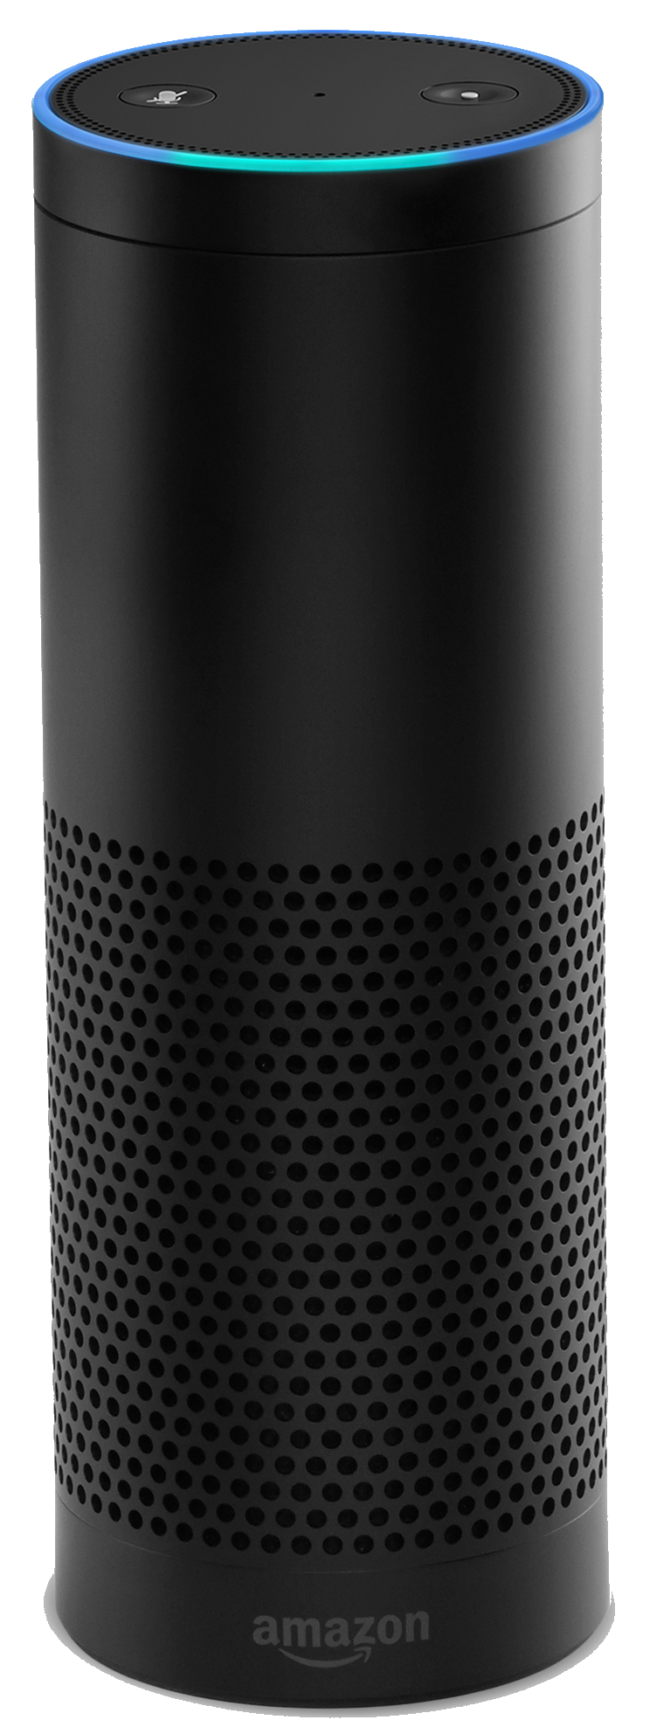
Alexa
Developed in Lab126 in 2010
Project A – Kindle
Project B – Fire Phone
Project C – ???
Project D – Echo (aka Doppler/Flash)
Released in Nov. 2014
http://www.bloomberg.com/features/2016-amazon-echo/
Notes:
How many people own an Alexa?
How many have played around with the Alexa Skills Kit?
How many have published some skills?
Born November 2014...
Echo dev. started in 2010.
Acquisitions to help do the speech stuff
Yap in 2011, Evi in 2012, IVONA in 2013.
Important to understand that Alexa is not just the Echo
Lab126 developed Kindle, Fire TV, Fire Phone, and Echo (codename Doppler… originally called Amazon Flash)
Story goes, Echo is Project D. A was the Kindle. B was the Fire Phone. C is not yet released. D was an offshoot... and became the Echo.
Let’s look into Alexa a little to understand what makes her special

Slide 6
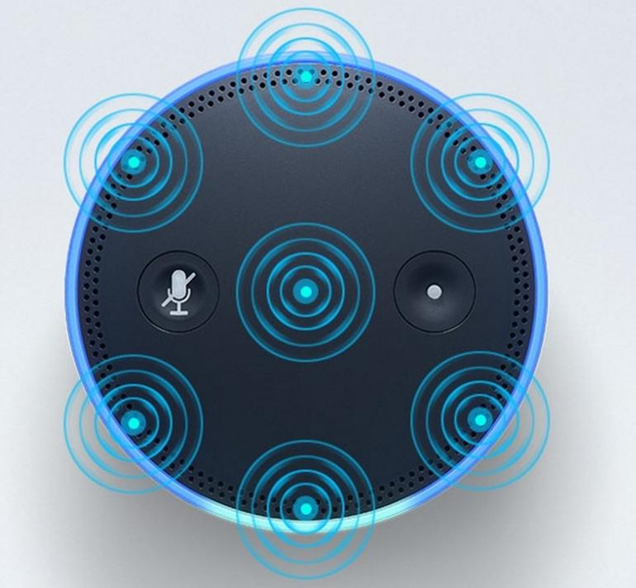
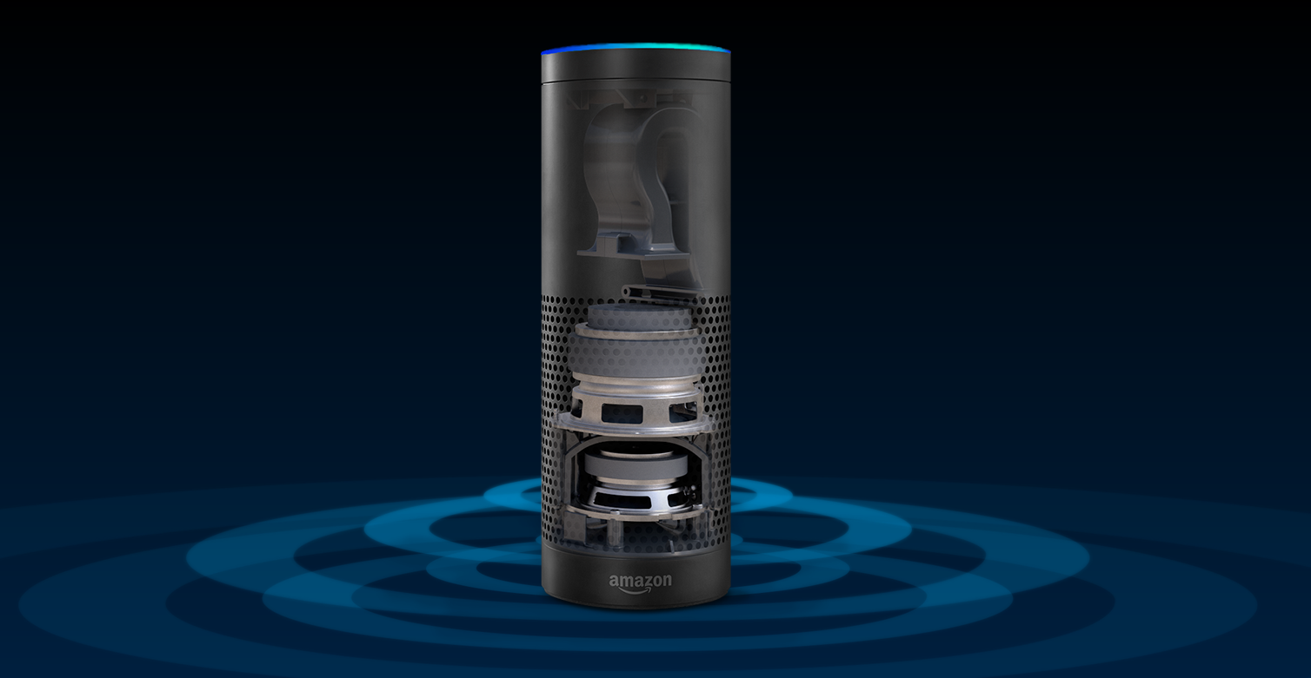
Alexa
Microphones
Speakers
Ring of LEDs
Notes:
Far-field 7 microphone array – one of the two most important features of Alexa
Decent speaker
LED ring
Connects using WiFi
Brains are in the cloud
constantly improving ASR / NLU engine
But this isn’t the only Alexa device

Slide 7
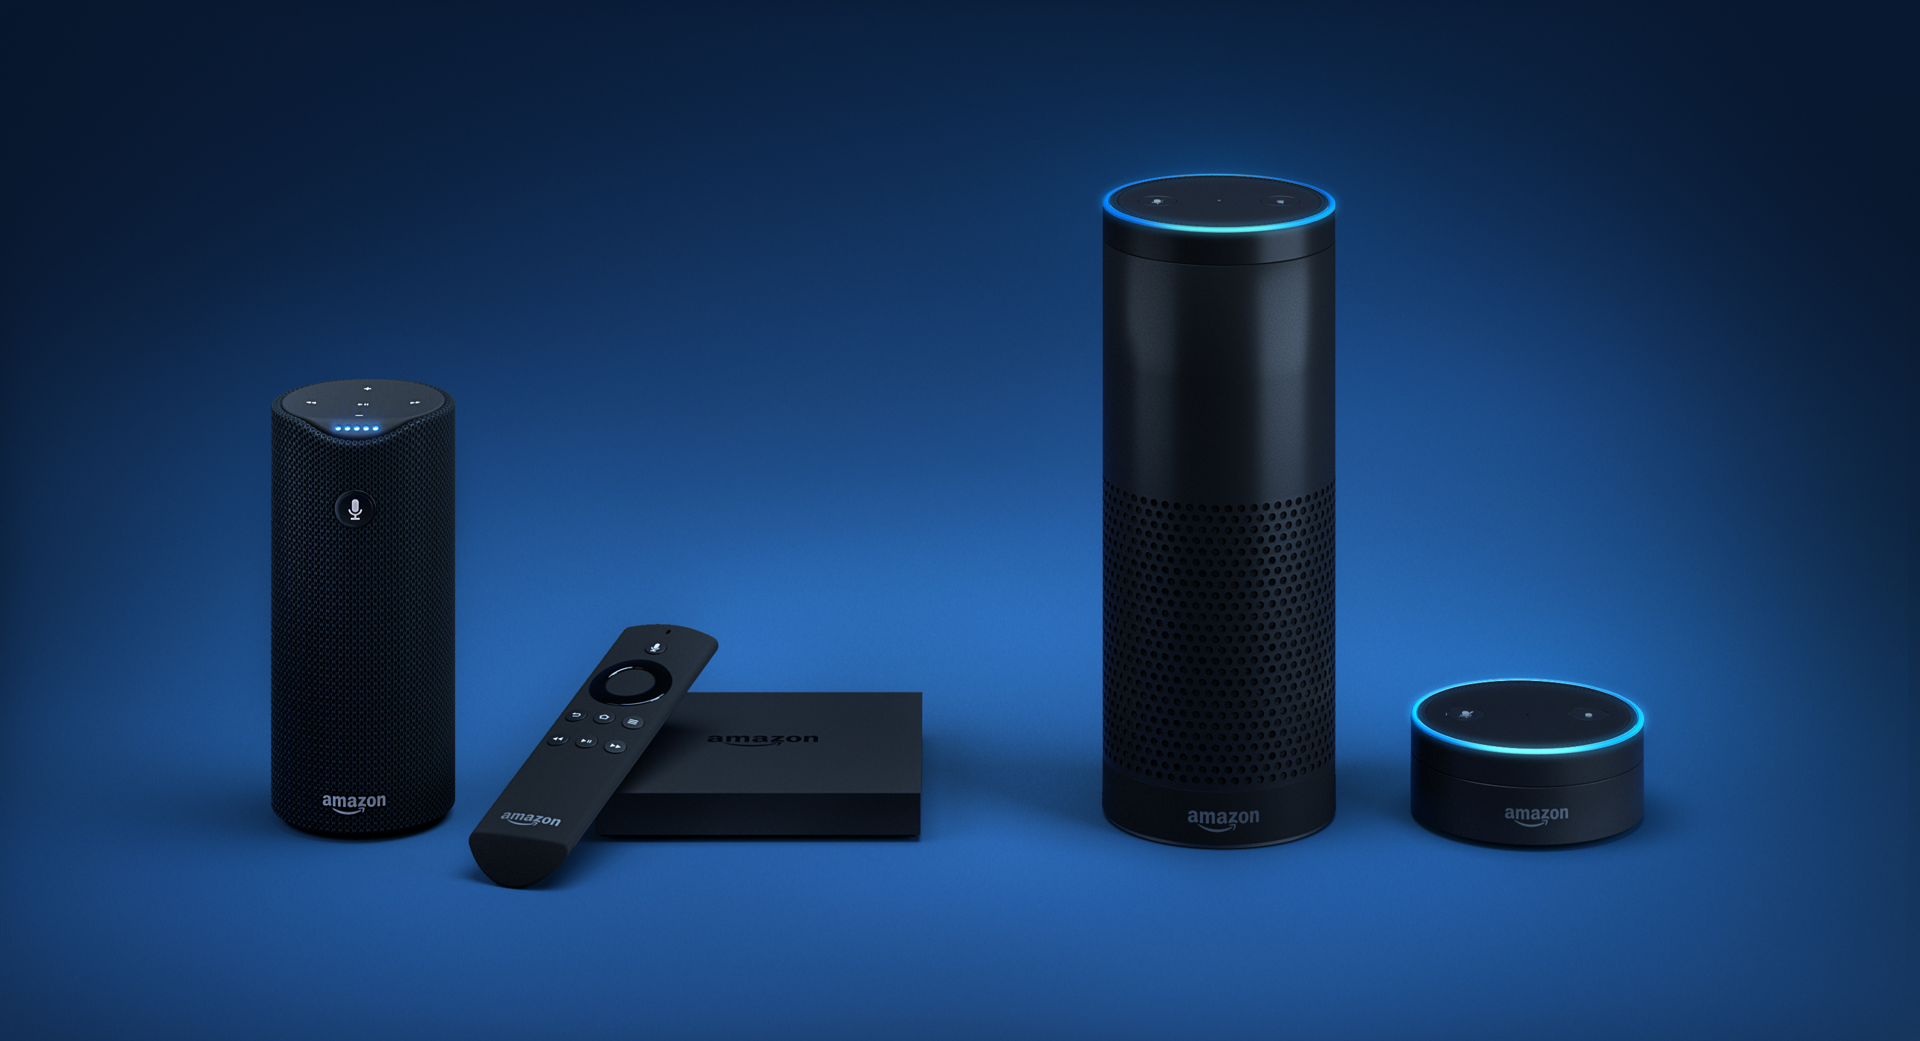
Alexa
Notes:
Tap
Fire TV
Echo
Dot
But these aren’t all the devices

Slide 8
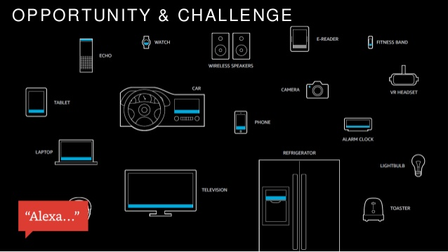
Alexa
http://www.slideshare.net/firstmarkcap/amazons-echo-the-present-and-future-of-alexa-donn-morrill-amazon-firstmarks-hardwired-nyc
Notes:
Donn Morrill is the Senior Manager of Solutions Architecture for Amazon's Alexa (Echo) team
Raspberry Pi
CHIP

Slide 9
Echo could be “The Fourth Pillar” of Amazon, building on its retail marketplace, Amazon Prime subscription service, and Amazon Web Services divisions.
Amazon CEO Jeff Bezos
Notes:
He envisions many AI devices in the home… each very good at their job.
Amazon hired over a thousand jobs in the last year, dedicated to Alexa. Check out http://www.amazon.jobs.

Slide 10
Talking Points
What is Voice UI/UX?
Benefits
7 Foundational VUI Attributes
Intro to Alexa Skills Development
Alexa VUI Tips & Tricks
Notes:
I want everyone to understand the landscape and give a quick intro into what things to consider when developing for voice

Slide 11
Acronym Soup
ASR – Automated Speech Recognition (Listen)
NLU – Natural Language Understanding (Understand)
AVS – Alexa Voice Service (Process)
TTS – Text To Speech (Respond)
VUI – Voice User Interface
ASK – Alexa Skills Kit
AWS – Amazon Web Services
SSML – Speech Synthesis Markup Language
AI – Artificial Intelligence
ML – Machine Learning
NLP – Natural Language Processing
Notes:
Introduce some concepts and the acronyms that represent them
NLU – If I ask Where is the Star Trek Beyond playing?, AVS has to take that phrase and understand that I’m talking about a movie. And I need to figure out locations.

Slide 12
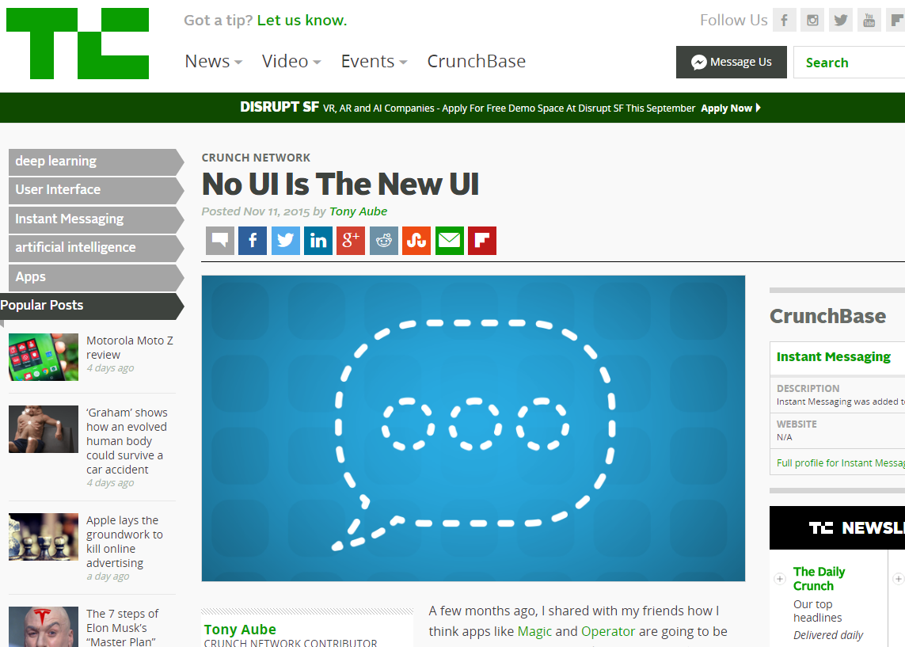
What is Voice UI/UX?
https://techcrunch.com/2015/11/11/no-ui-is-the-new-ui/
Notes:
Media has described this as No UI.
Think about VUI as human conversation.

Slide 13
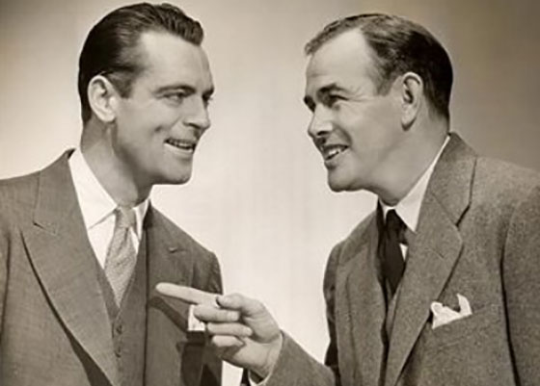
Conversational UI
Notes:
You have experienced VUI/VUX anytime you’ve had a conversation with someone.
What is the main medium of this UI? Speech?

Slide 14


Speech
Speech is primitive
In the womb, babies recognize their mother’s voice
Psychology of human interactions with voice from a computer mimic human to human interactions
http://gizmodo.com/5632237/the-man-who-lied-to-his-laptop
Notes:
Professor Nass research. Brain is hardwired to respond to speech.
Talk about the Clippy anecdote?
1998 Microsoft asked Clifford to improve Clippy
Was it because Clippy animated and adults don’t like animation? No. Homer Simpson.
Understood that Clippy wasn’t smart enough, didn’t learn and frustrated users.
Turn Clippy into a friend. Ask if he was helpful… anytime someone said no, let the user know that it gets you angry that Microsoft isn’t helpful and offers to send an email about how bad their help system is.
After couple of minutes to type a complaint, Clippy would say, "C'mon! You can be tougher than that. Let 'em have it!“
Microsoft didn’t want to make them an enemy, so they cancelled Clippy

Slide 15
Benefits of Voice UI
Fast input
Humans speak on average 150 vs. type 40 words per minute
Hands-free
Clean and simple interface
Easy to implement (microphone + speaker)
$50 package Raspberry Pi 3 running AVS
Utilizes NLP
Notes:
Clean & Simple interface
You can think of your initial start page as the Google Home Page with just a blank search box when you start speaking vs. having multiple menu options to learn from.
NLP
Service is implemented using NLP, so you'll naturally get context, location, personalized features that are used in NLP

Slide 16

Benefits of Voice UI

Slide 17
Why Voice User Interfaces Now?
Server farms w/ lots of computing power
Enormous knowledge graphs w/ lots of facts
Image recognition improvements assist machine learning
Affordable hardware can accomplish complex tasks
Broadband affordable and available at home
USA households: 80% internet at house (although 13% only have smartphones)
People are starting to try and trust voice input
Voice assistance on the phone (30% in 2013 - 65% in 2015)
Notes:
Pew Research 2015 showed internet at home plateaued at 70% - 67% w/ 8% - 13% smartphone people w/o home internet
http://www.pewinternet.org/2015/12/21/home-broadband-2015/
Moving to Voice UI is like Web -> mobile dev. Understand your limitations before you start developing

Slide 18


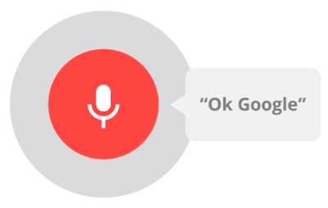
Voice Responsiveness
Movie lookup “Where is Star Trek Beyond playing?” | 3.5 | 6.0 | 5.5
Set a reminder “Remind me to pick up milk.” | 2.7 | 5.0 | 6.0
Fact lookup “How tall is the Eiffel tower?” | 2.2 | 5.3 | 5.6
Time in seconds
Source: http://www.tomsguide.com/us/best-voice-assistant,review-2893.html
Dec 5, 2014 (around the timeframe Echo was being designed in secret)
Notes:
Jeff Bezos wanted the team to beat 3 seconds. They delivered. He tested it out and asked them to beat 1 second response.

Slide 19
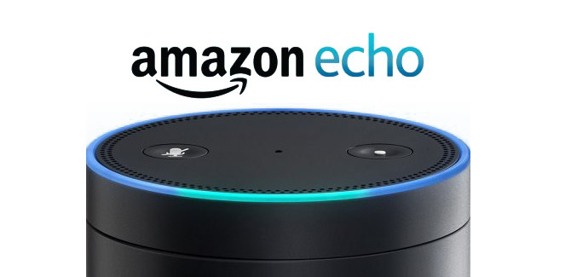
Voice Responsiveness
Movie lookup “Where is Star Trek Beyond playing?” | 3.5 | 6.0 | 5.5 | 0.6
Set a reminder “Remind me to pick up milk.” | 2.7 | 5.0 | 6.0 | 0.5
Fact lookup “How tall is the Eiffel tower?” | 2.2 | 5.3 | 5.6 | 0.4
Time in seconds
Source: http://www.tomsguide.com/us/best-voice-assistant,review-2893.html
Dec 5, 2014 (around the timeframe Echo was being designed in secret)
Notes:
Engineers delivered.
NLP -> Text -> Alexa Service -> Text -> TTS
What has the potential of beating Alexa? Someone with more cloud infrastructure, better knowledge graphs… Google.

Slide 20
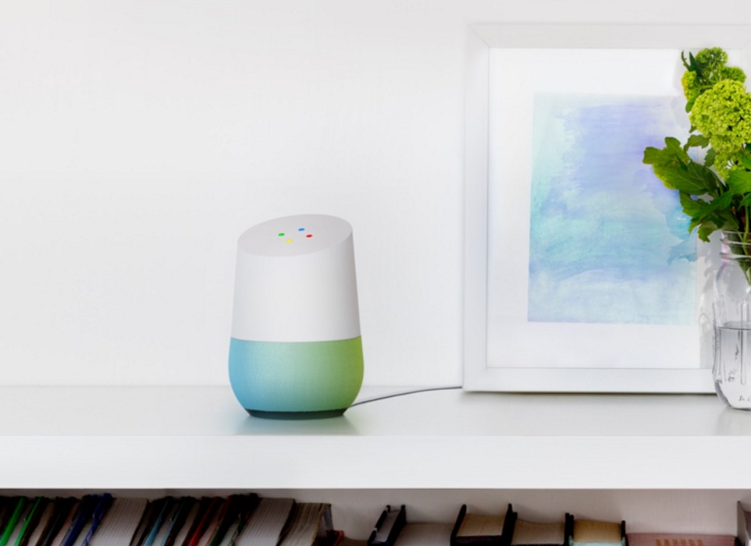
Alexa’s Competition!
Google Home
Announced at I/O
Available late 2016?

Slide 21
7 Foundational Attributes of VUI Applications

Slide 22
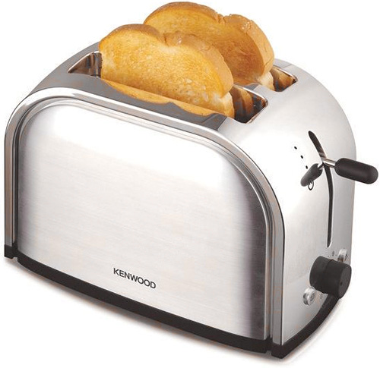
Useful
Useful
Does it do something people need done?

Slide 23
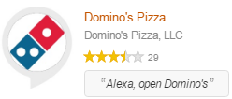
Useful
Dominos Website
Dominos Alexa Skill
Place an Easy Order
Reorder your most recent order
Check status of current order
See order history
Build a pizza
Add any side, sandwich, etc
Find coupons
Place an Easy Order
Reorder your most recent order
Check status of current order

Slide 24

Useful
Uber App
Uber Skill
Order a ride from UberX, UberBlack, etc
Check status of your ride
Order a ride from UberX, UberBlack, etc
Check status of your ride

Slide 25

Learnable
Useful
Learnable
Can people figure out how to use it?

Slide 26
Learnable
Familiar UI missing in VUI
No hover-over tool tips
No labels to describe choices
No drop down lists
VUI Suggestions
Provide choices in response
Offer tutorial
Contextual help
Keep it simple
Notes:
Contextual help means to use to things you already know, without having to re-ask them.

Slide 27
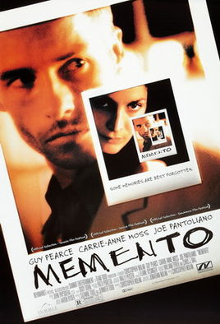
Memorable
Useful
Learnable
Memorable
Do they have to relearn it each time they use it?
Notes:
There are some skills on Alexa that are difficult to use. I have a number of LIFX lightbulbs and there is a skill I installed that allow me to control those bulbs. However, the phrase I need to use is extremely long and requires very specific commands spoken at the right times. “Ask LIFX to set the Living Room Lights to the color blue”.
Using variances in acceptable skill responses can allow your skill to be useful, learnable, and memorable… just because it isn’t so rigid.

Slide 28
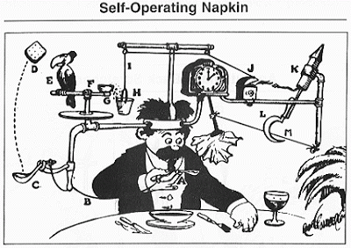
Effective
Useful
Learnable
Memorable
Effective
Does it get the job done?
Notes:
If a skill only does half of what you need, and you have to use another system to finish it, then you need to rethink your application.
Sometimes you’ll ask Siri a question while you’re driving, and her response will be ”I found this on the web for you”

Slide 29
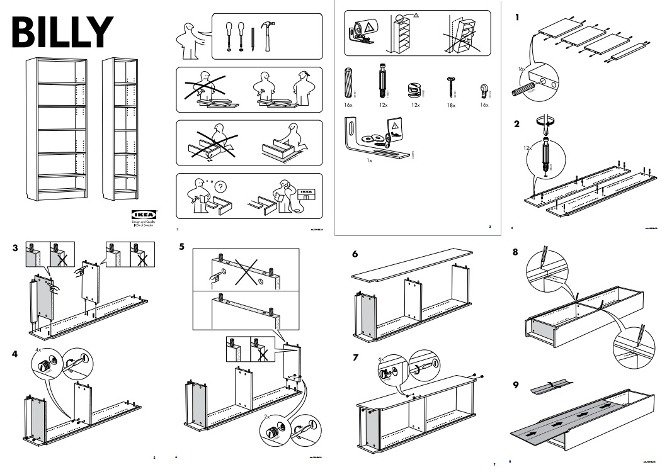
Efficient
Useful
Learnable
Memorable
Effective
Efficient
How much time and effort does it take to use the app?

Slide 30

Desirable
Useful
Learnable
Memorable
Effective
Efficient
Desirable
Do people want to use it?

Slide 31

Delightful
Useful
Learnable
Memorable
Effective
Efficient
Desirable
Delightful
Is using it enjoyable, or even fun?
Notes:
Cherry on top. Alexa responding to commands makes me happy most of the time.

Slide 32
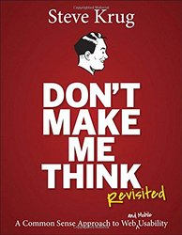
7 Attributes of VUI Applications
1
2
3
4
5
6
7
Useful
Learnable
Memorable
Effective
Efficient
Desirable
Delightful
Steve Krug’s Usability Principles
Notes:
Time check, 30 minutes
Best VUI apps end up being short conversations and quick answers

Slide 33
Alexa Development
Quick Intro

Slide 34
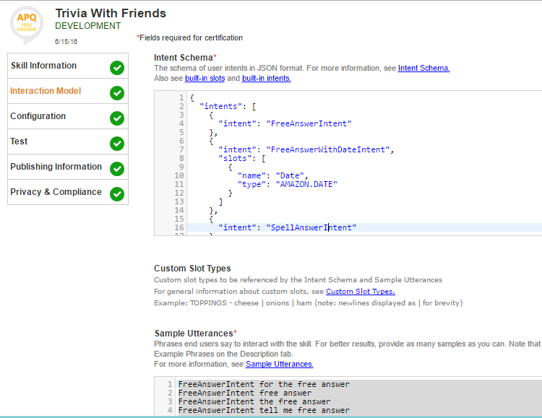
Schema
Slots
Intents
Utterances
Notes:
3 components to a schema

Slide 35
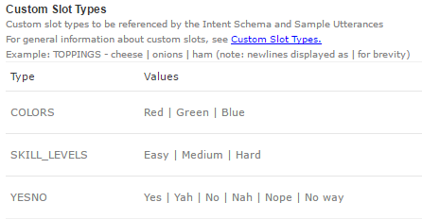
Slots
Built-In
AMAZON.DATE, AMAZON.US_STATE, many more…
Custom
Enumeration
Pro-tip: Add slots first when building a skill

Slide 36
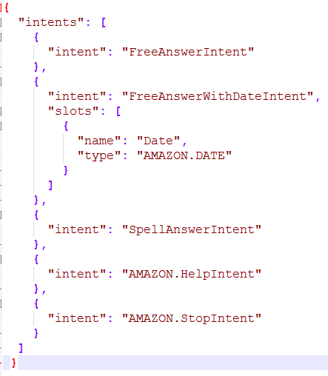
Intents
Functions / states of application
Defines slot options

Slide 37
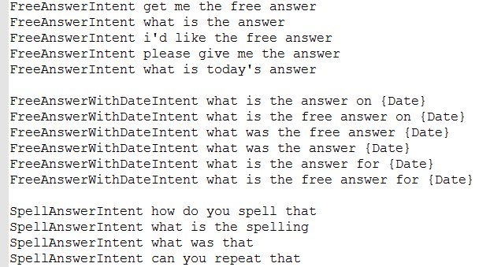
Utterances
Example phrases for matching spoken words
Utilizes AVS’s NLP to match an intent and populate slots
Notes:
I usually build utterances second. But the whole process for me is a bunch for me is a bunch of back and forth

Slide 38
Custom Skills Demo

Slide 39
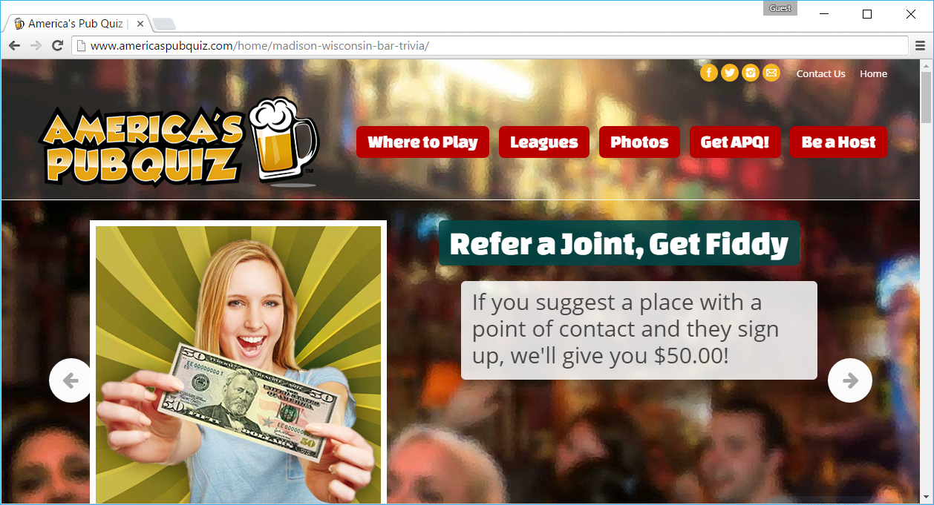
Trivia With Friends
http://www.americaspubquiz.com
Notes:
Show today’s answer and tomorrow

Slide 40
VUI Attribute Checklist
Useful - Tells me the free answer
Learnable - Nothing to learn
Memorable - Only the skill name
Effective - Faster than doing it the old way
Efficient - Finds the answer as fast as my scraper can run
Desirable - I go to trivia once a week, so I use it weekly
Delightful - I smile every time Alexa answers me
Useful
Learnable
Memorable
Effective
Efficient
Desirable
Delightful

Slide 41

Skills or built-in SYSTEM intents?
Skills require a launch command
“Alexa, Launch [SkillName]”
“Alexa, Ask [SkillName]”
“Alexa, Open [SkillName]”
“Alexa, Tell [SkillName]”
Notes:
AVS has to decide if this is a custom skill

Slide 42
Tips & Tricks for Alexa’s Voice UI
Notes:
45 minutes in

Slide 43

Allow one-shot phrases
Limits the back and forth
Provide multiple answers at one time
Useful
Memorable
Effective
Efficient
Notes:
One-shot allows you to ask your skill and provide a lot of information in one command

Slide 44
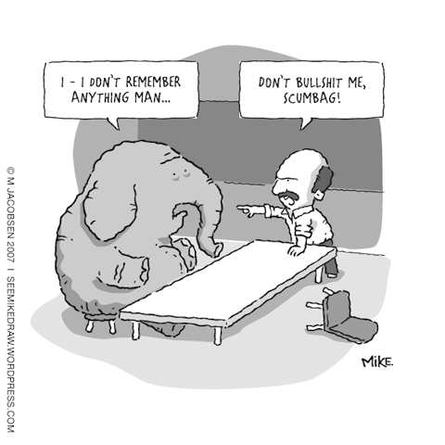
Leverage learning
Use DynamoDB to store answers
Learnable
Useful
Efficient
Desirable
Notes:
If you ask for zipcode, don’t ask again next time
Provide a list of local items and you pick a favorite, remember it

Slide 45

Always provide options
Let the user know their choices
Provide definitive choices
Alexa: The red pill or the blue pill?
You: Yes
Useful
Learnable
Effective
Notes:
Make It Clear that the User Needs to Respond
Which pill, red or blue?

Slide 46

Explain errors
Alexa: The red pill or the blue pill?
You: Yes
Alexa: That was not an option, please say red or blue.
Useful
Learnable
Effective
Notes:
Explained the error and provided options in response.

Slide 47
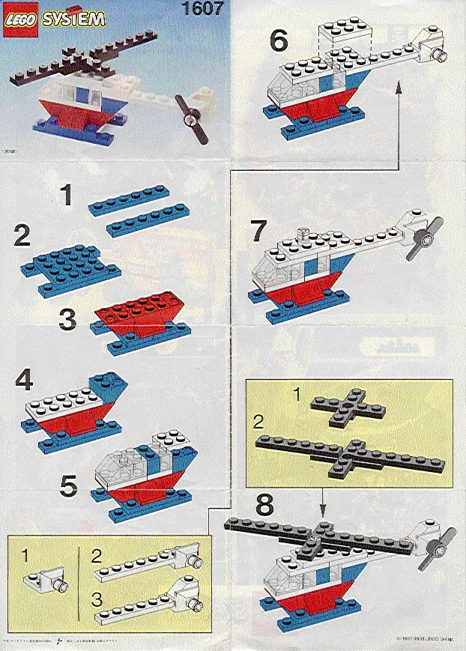
Learn as you go
Don’t need to explain all options in the beginning
Explain options at each transition
Useful
Learnable
Effective
http://lego.brickinstructions.com/01000/1607/001.jpg

Slide 48
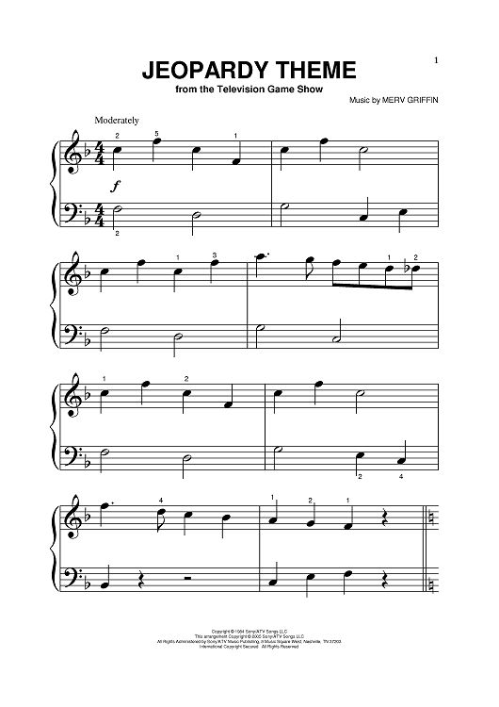
Create a brand
Use SSML sound clips to intro your skill
(e.g. ESPN and Jeopardy)
Memorable
Delightful
Notes:
You don’t have a logo, color scheme, graphics to rely on for your brand.

Slide 49
Be funny
Funny replies are hunted out by people
Humor > boring
Memorable
Effective
Delightful
Notes:
Adding humor into apps / chatbots, isn’t just about creating easter eggs that people try to find and tweet about. There is human psychology involved too, where people like to hang out with funny people more often than boring people.

Slide 50
Takeaways
Best VUI apps: short conversations and quick answers
Test your app with Steve Krug’s 7 Usability Attributes
Does your app respond like a human would?

Slide 51

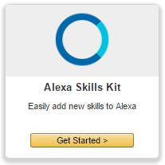
Apply New Skills
Develop an Alexa Skill
developer.amazon.com
github.com/amzn/alexa-skills-kit-js
echosim.io
www.bignerdranch.com/blog/tags/alexa-skills-kit/
Publish your skill and get a TShirt

Slide 52
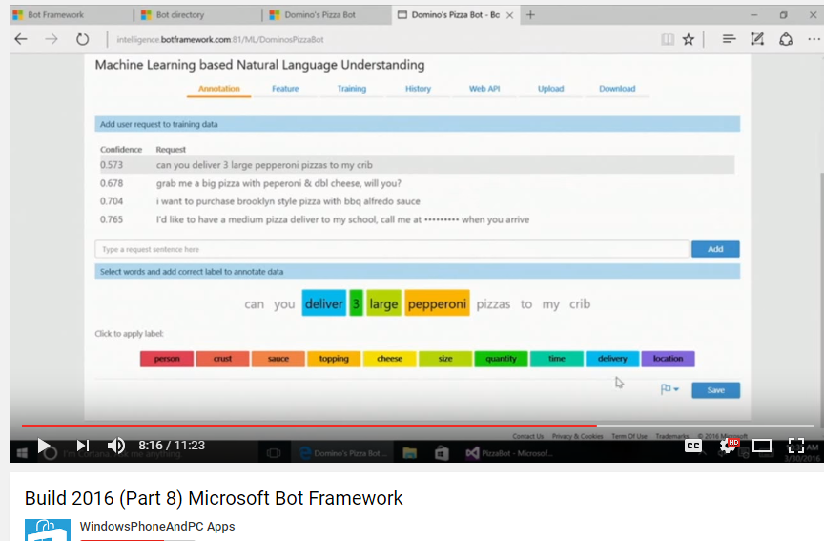
Apply New Skills
Microsoft Bot Framework
Announced at BUILD 2016
Helpful intent/utterance builder

Slide 53
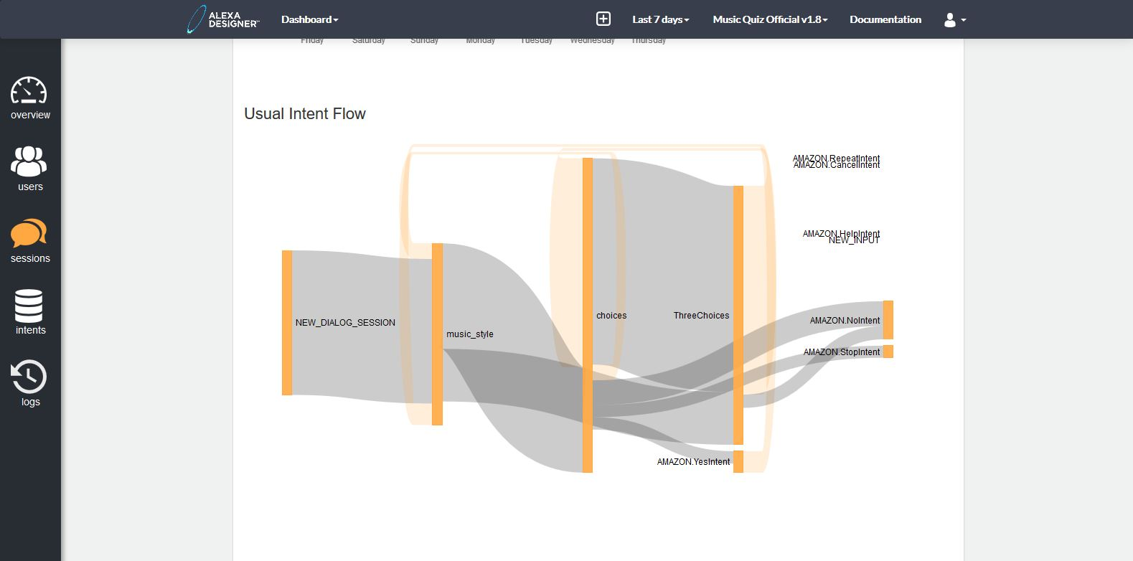
Apply New Skills
Create a cross-platform voice/chat app
https://www.alexa-designer.com
https://smartly.ai/

Slide 54



Questions / Comments
chris@chrispauly.com
chrispauly.blogspot.com
github.com/chrispauly
Notes:
With prebuilt AI services becoming readily available to developers, there have been a lot of advancement in software packages taking advantage of these. Some of these are chatbots.
Microsoft, Slack, Facebook Messenger, Skype… so many services have a chatbot SDK available now.
This last year, at the Georgia Institute of Technology, an AI class was surprised to find that for the whole semester, one of their TAs was actually an AI chatbot named Jill. In previous years, 10,000 online messages would be sent from the students, and it was a lot to keep up with. Many students complained about low teacher support during the school year and so the professor and his grad students built a chatbot to assist with questions asked online at all hours of the day.
http://sdtimes.com/sd-times-blog-ai-getting-smarter/
Or how about the story from 2013 of a Robot Telemarketer, named Samantha West. Premeire Health Plans was making cold calls to potential customers and found a more affordable way to do that without the typical robocaller. Customers would get a call from a person with a real human voice, but something sounded off about the voice. The emotions expressed in the voice seemed robotic and un-changing. She seemed to answer questions , but seemed to keep on a script. It turns out, the company had hired low wage workers across the ocean, but the goal was to hide the thick accents that come with foreign phone support. So, the agent had a soundboard of canned phrases that they could “say”.
http://newsfeed.time.com/2013/12/10/meet-the-robot-telemarketer-who-denies-shes-a-robot/
The content and ideas of this talk can be applied across the board to chatbots, however I am going to focus on voice only interfaces, specifically the Amazon Alexa Service.

Slide 55
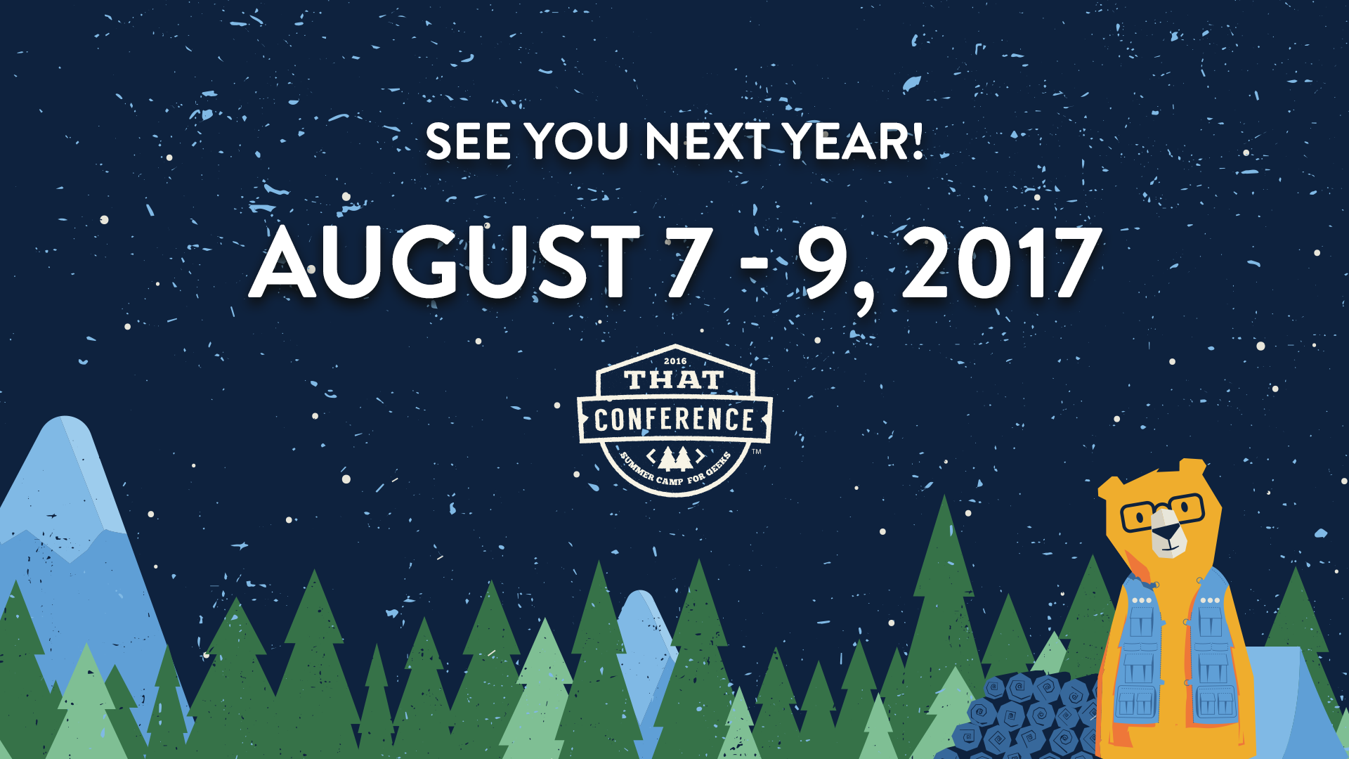
Notes:
exports.handler = function (event, context) {
context.succeed(buildResponse({}, buildSpeechletResponse(
"thatConference",
"Bacon",
"",
true
)
));
}

